Slide 1

CUI WAH CAMPUS
COMSATS University Islamabad, Wah Campus
Department of Computer Science
LECTURE # 12
SUBJECT NAME: Automata Theory
INSTRUCTOR: Waheed Ahmad Khan

Slide 2

Topic Covered
Non Deterministic Finite Automata/ NFA ,

Slide 3
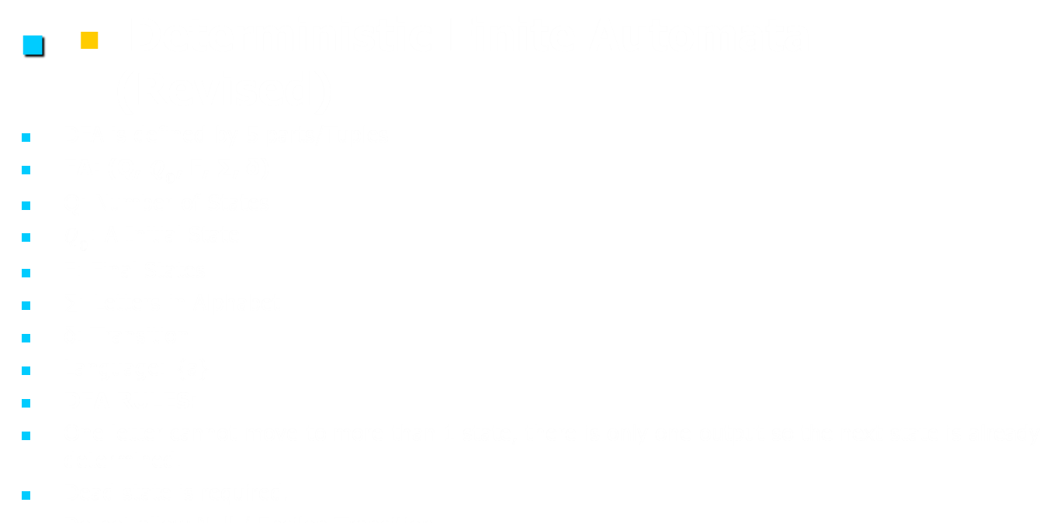
Deterministic Finite Automaton (DFA)

Slide 4
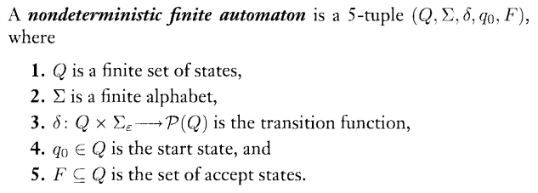
Non Deterministic Finite Automata NFA
DEFINITION:

Slide 5
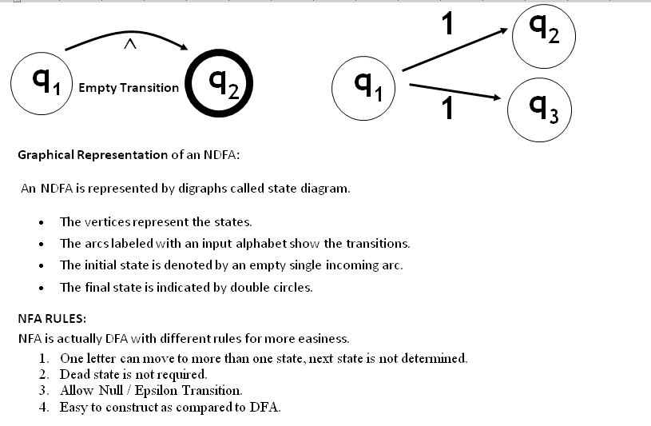
Non Deterministic Finite Automata NFA/ NDFA

Slide 6
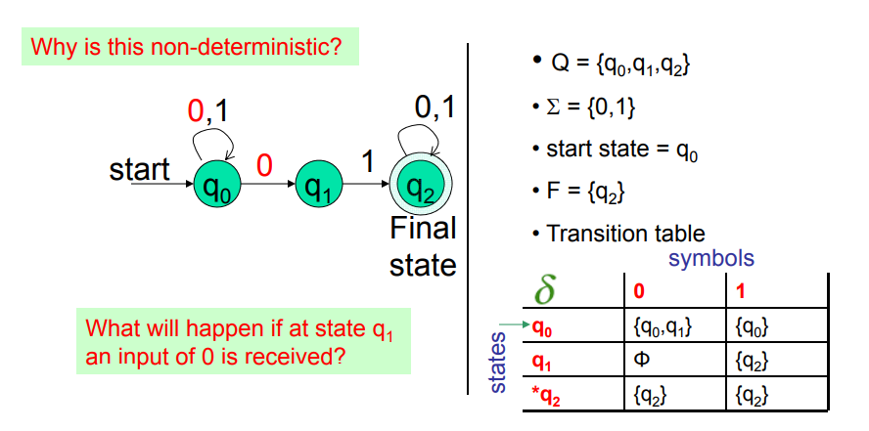
Non Deterministic Finite Automata NFA/ NDFA
EXAMPLE 1: NFA for strings having substring 01 over ∑={0,1}
Regular expression: (0+1)*01(0+1)*

Slide 7
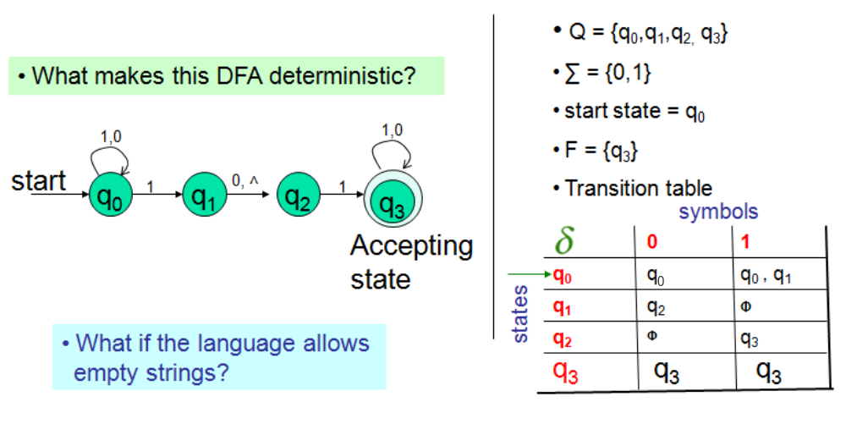
Non Deterministic Finite Automata NFA/ NDFA
EXAMPLE 2: NFA for strings having substrings 101 or 11 over ∑={0,1}.
Regular expression: (0+1)*(101+11)(0+1)*

Slide 8
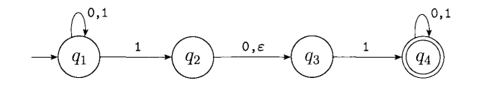
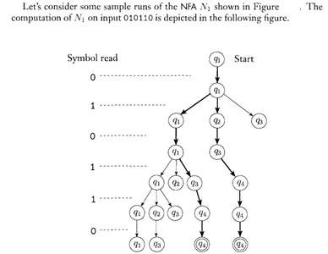
Non Deterministic Finite Automata NFA/ NDFA

Slide 9
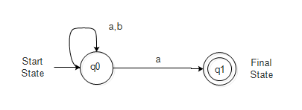
Non Deterministic Finite Automata NFA/ NDFA
EXAMPLE 4: Accept all words ending with a, over ∑={a,b}
Regular expression: (a+b)*a

Slide 10
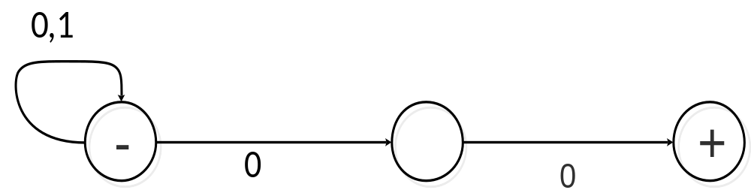
Non Deterministic Finite Automata NFA/ NDFA
EXAMPLE 5: Accept all words ending with 00, over ∑={0,1}
Regular expression: (1+0)*00

Slide 11
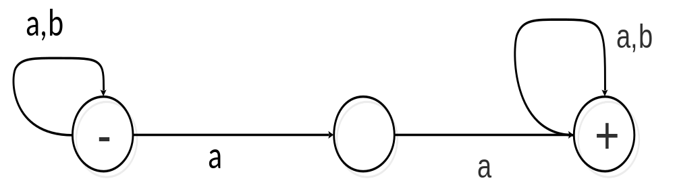
Non Deterministic Finite Automata NFA/ NDFA
EXAMPLE 6: Accept all words that contains substring aa, over ∑={a,b}
Regular expression: (a+b)*aa(a+b)*

Slide 12
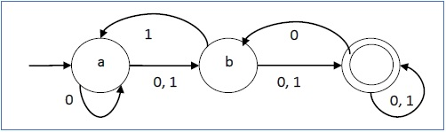
Non Deterministic Finite Automata NFA/ NDFA
Let a non-deterministic finite automaton be →
Q = {a, b, c}
∑ = {0, 1}
q₀ = {a}
F = {c}
The transition function δ as shown below −
Its graphical representation would be as follows −
Present State | Next State for Input 0 | Next State for Input 1
A | a, b | B
B | C | a, c
C | b, c | C

Slide 13
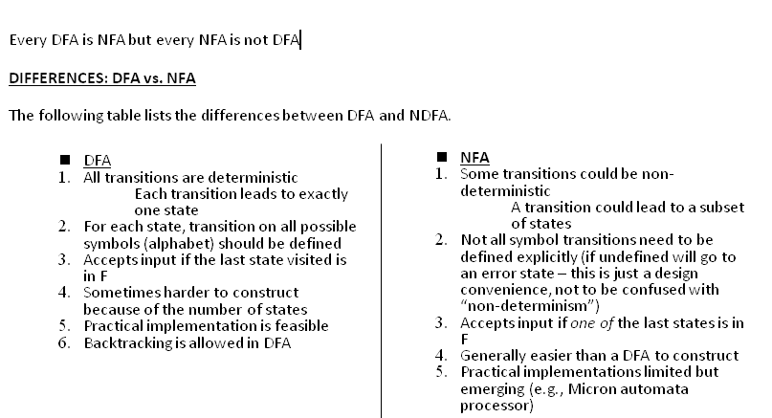
Non Deterministic Finite Automata NFA/ NDFA

Slide 14
ASSIGNMENT 4:
An NFA and DFA that accepts any binary string that contains 00 or 11 as a substring.
An NFA and DFA that accepts all binary strings that end with 101.
An NFA and DFA for a* + (ab)*
An NFA and DFA that Accepts all binary strings where the last symbol is 0 or that contain only 1’s.
Draw a deterministic and non-deterministic finite automate which accept 00 and 11 at the end of a string containing 0, 1 in it, e.g., 01010100 but not 000111010.
An NFA for the language a*b*c*.

Slide 15
Thank You…

